Slide 1


Slide 2

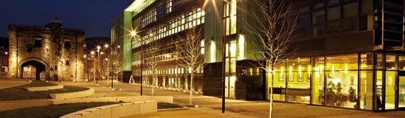
De Montfort University
Jan Martin – Senior Lecturer – Centre of English Language Learning
Jo Poon - Senior International Officer
International Office

Slide 3

Location of DMU - Leicester City
Central location, east midlands region
70 minutes by train to London
Easy to travel to other UK cities
Only 3 hours to Paris by Eurostar train
Leicester
London

Slide 4
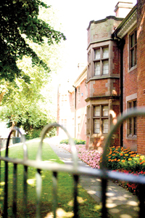
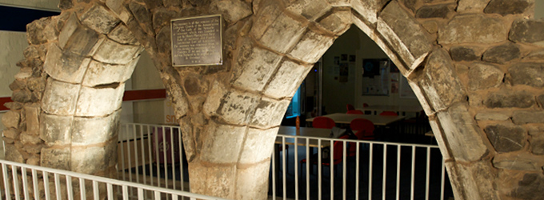
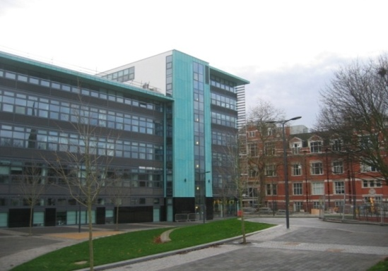
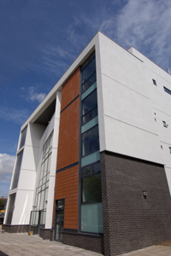
An Overview
1870, Leicester School of Art and Technology established
1967, Leicester Polytechnic
1992, De Montfort University, including:
  Four faculties: Art, Design and Humanities; Business and Law; Technology; Health and Life Sciences
  Over 400 undergraduate and postgraduate subjects
  Over 20,000 students, supported by 2,700 staff

Slide 5
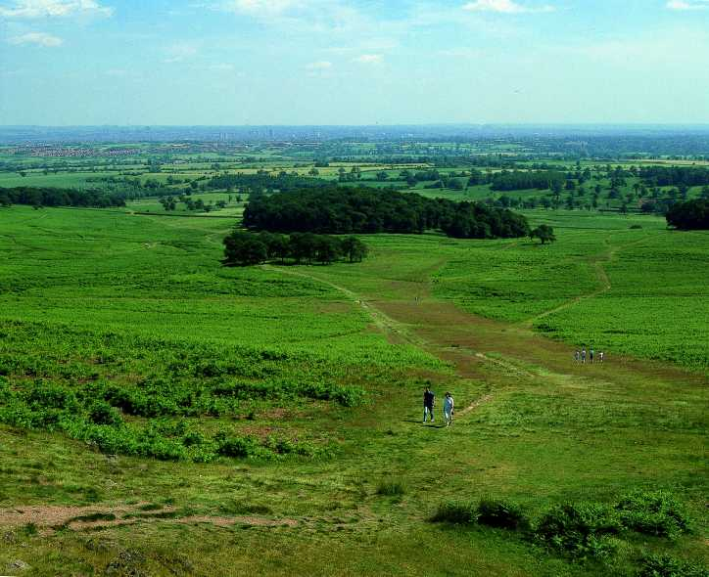
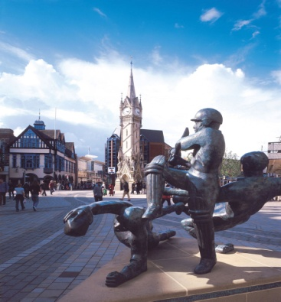
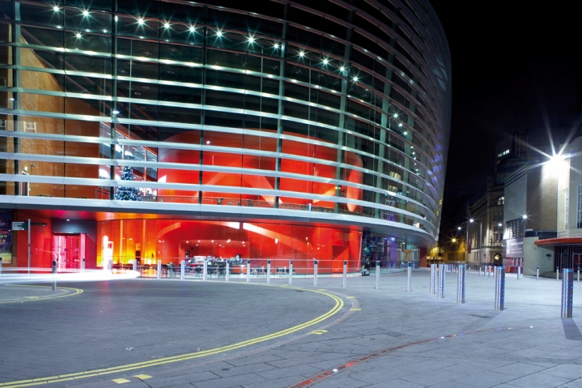
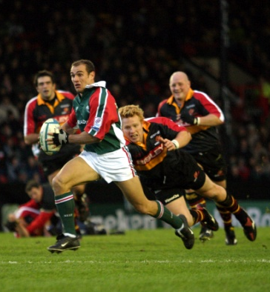
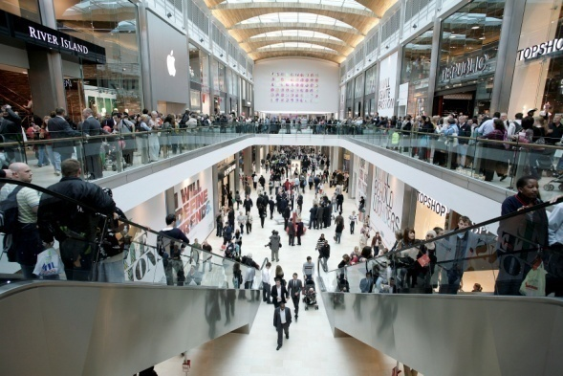
Vibrant City Life
Vibrant student experience
Lively city centre location
Excellent shopping and entertainment venues

Slide 6
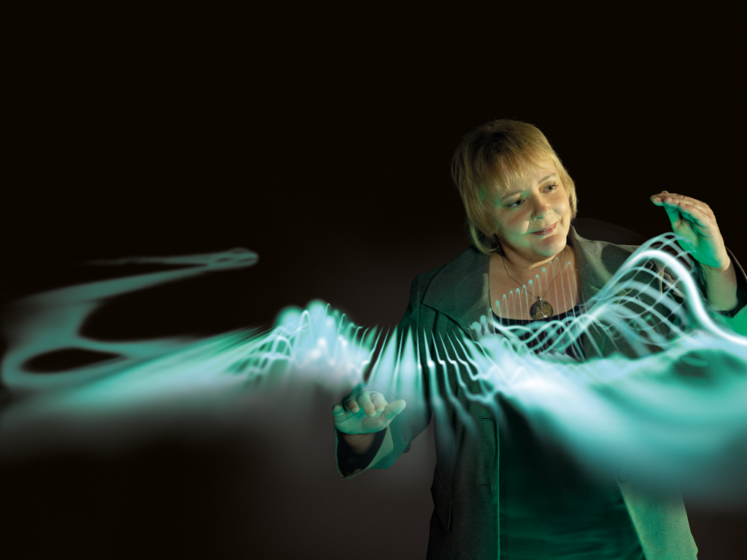
Quality and Distinctiveness
Teaching quality - 13 national teaching fellows, 2nd largest group of all UK universities
Research excellence - 50 research groups, 400 research projects; more than 40% research activities is rated “Internationally Excellent” or “World Leading”
Graduate employability – over 92% graduates finding jobs or pursuing further studies within 6 months after graduation

Slide 7

Faculty of Art, Design and Humanities
World-leading research
Award winning work
Innovative thinking
DMU graduate Leanne Brookes
UK Lingerie Award 2011 prize winner
Started her own label ‘Obey My Demand’
Clients include Lady Gaga and Alesha Dixon

Slide 8
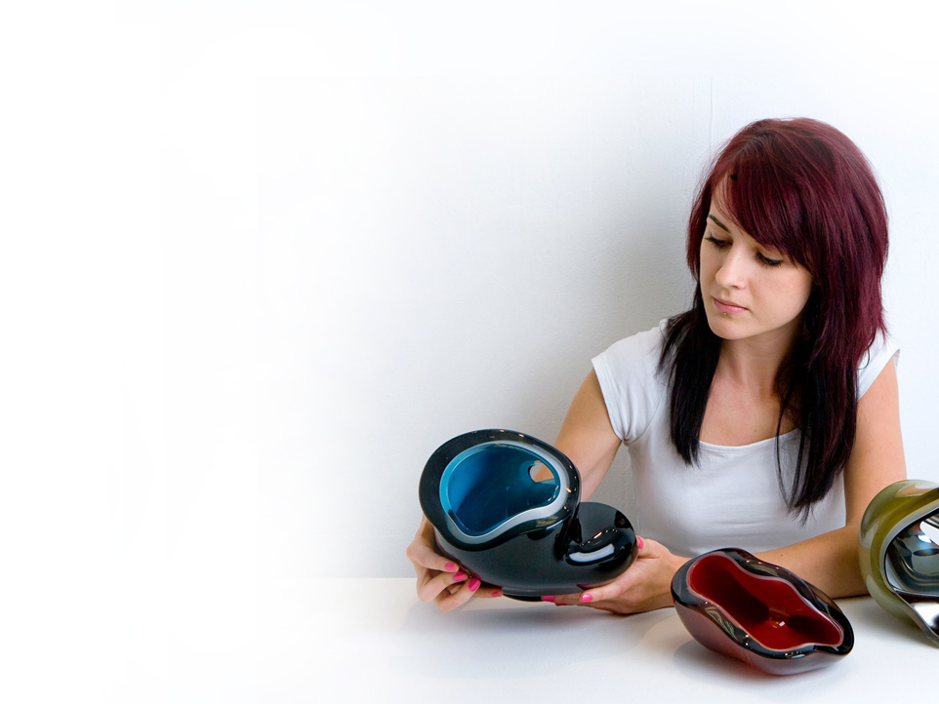
Excellent facilities (design)
Fashion and Footwear Facilities
Photography and Video Labs
Game Art and Animation
Design Facilities
Glass, Wood, Metal and
Soft Plastics Workshop
New state-of-the building for
Art and Design Faculty - 2016
DMU graduate Samantha Donaldson
Now studying MA Ceramics and
Glass at the Royal College of Art

Slide 9
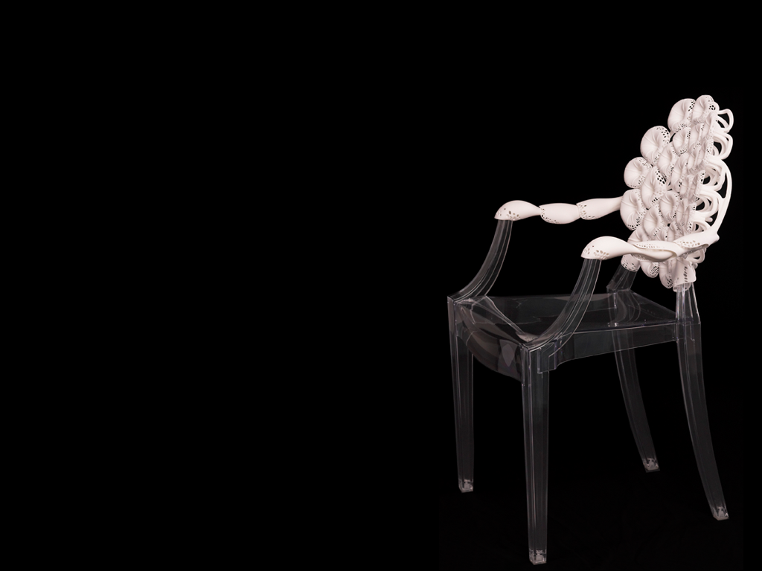
Our industry connections
Exhibitions and performances by DMU staff
100% Design, London
Brussels Biennial
Mori Art Museum, Tokyo
Cheongju International
Craft Biennial, Korea
New York Metropolitan Museum of Art
The National Gallery of Art, Washington, D.C.
Recent exhibitions and performances by DMU staff

Slide 10
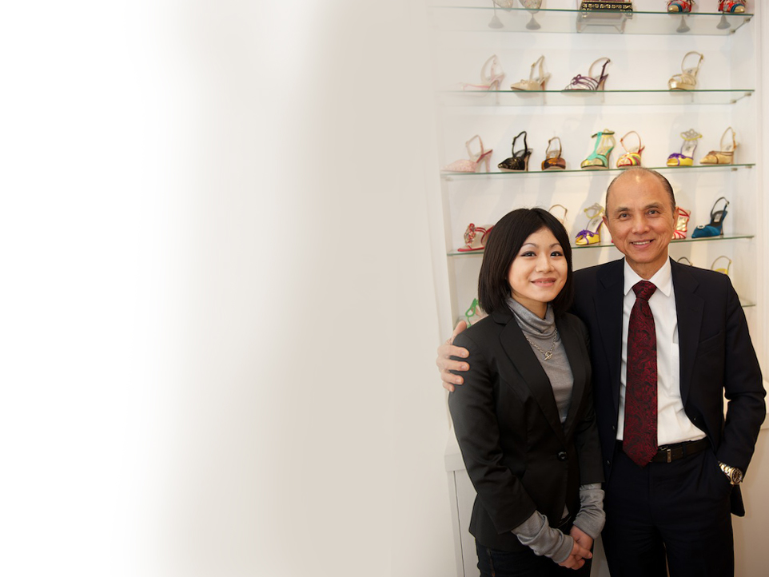
Our industry connections
Art, Design and Humanities staff have
impressive links with top industry
professionals
DMU graduate Cheng (Nikki) Lin
Footwear Design student Nikki impressed Jimmy Choo so much he invited her for a three month internship following her graduation.

Slide 11
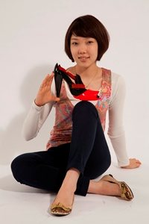
Success Stories
Future designer shines at
UK’s biggest footwear trade show
Japanese student Maya Nishimura was named winner of the History in the Making project, a coveted footwear award. The award is a joint collaboration between DMU and Moda Footwear, requiring a high degree of creativity and technical prowess.

Slide 12
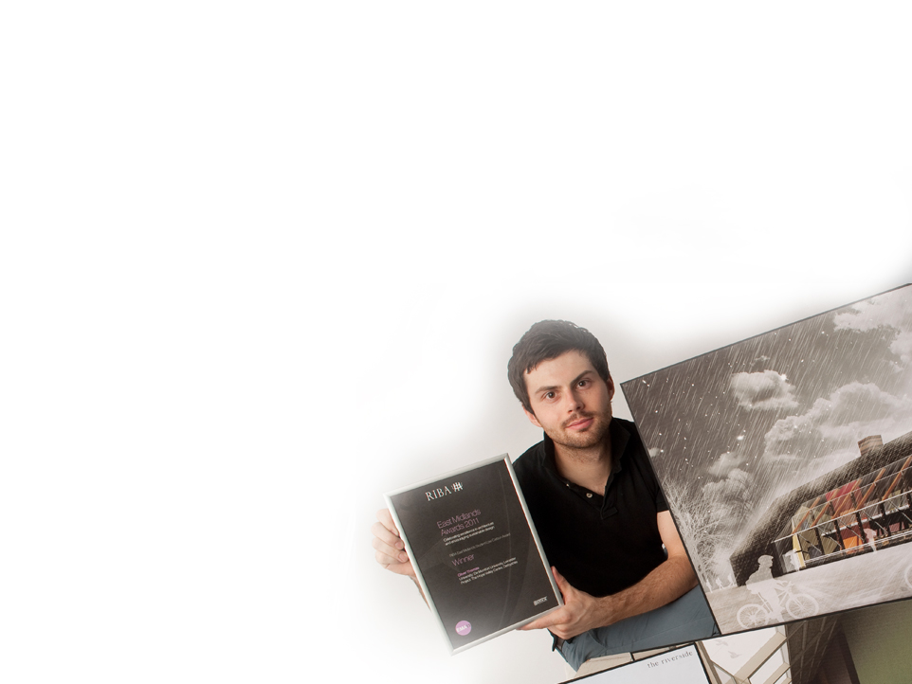
Success Stories
Student’s designs for Peak District hub wins sustainability award
Architecture student Oliver Thomas won an award from a prestigious architectural body for designing a sustainable activities hub for the heart of the UK’s Peak District.
Oliver was honoured by the Royal Institute of British Architects (RIBA) and OPUN, the architecture and design centre for the East Midlands, with the Student Low Carbon Design Award
for his Hope Valley Centre project.

Slide 13
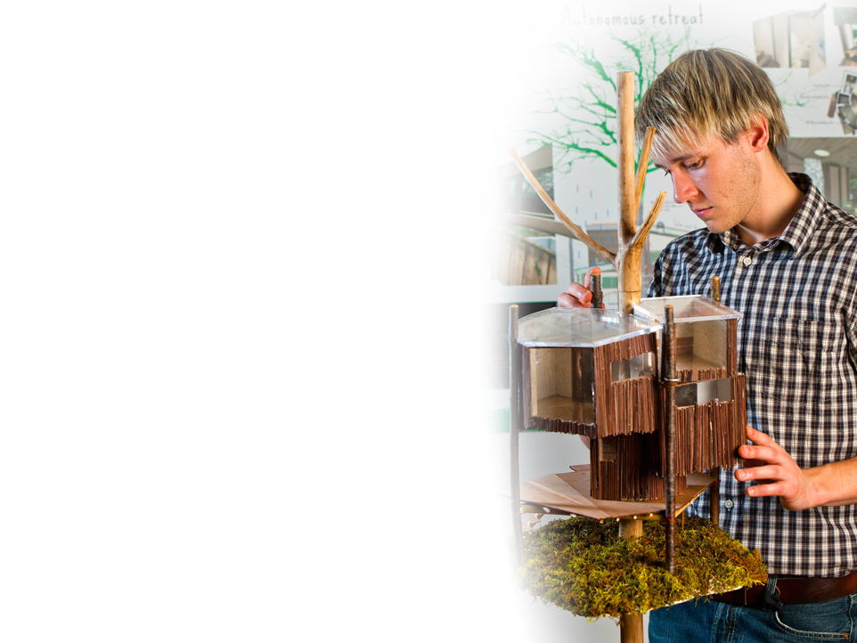
Success Stories
DMU student wins prestigious design award.
An innovative design for a green retreat for stressed out city dwellers has won a DMU student top prize in a national competition.
Luke Newman’s proposals for a self- sufficient tree house have earned him the prestigious New Designers Sky Award for this year’s best ecological project.
He was presented with his award at a ceremony at the Business Design Centre in London this year.

Slide 14
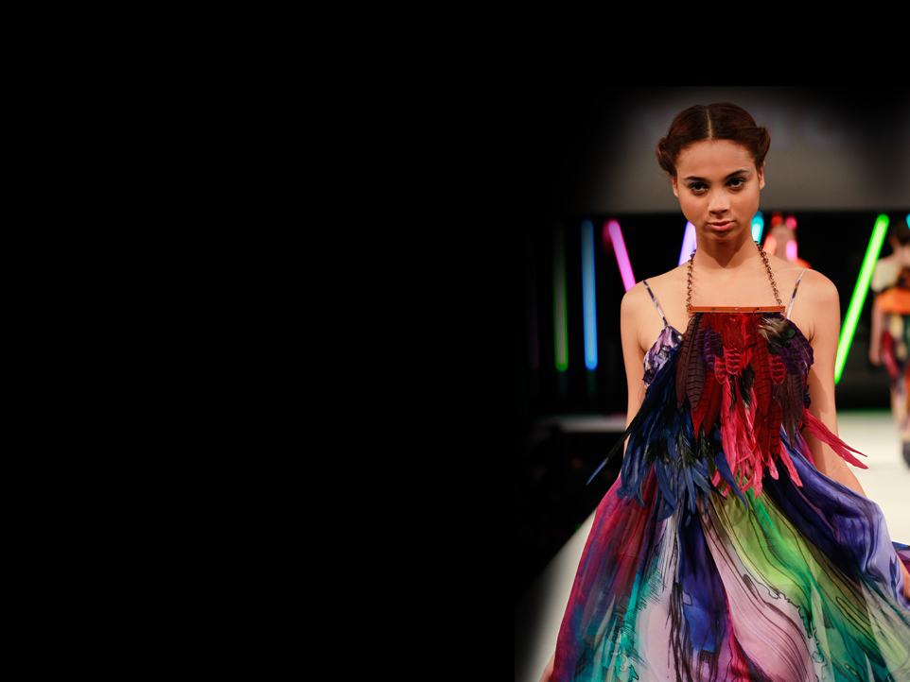
Success Stories
Fashion graduate’s collection sold in Warehouse
Award-winning fashion graduate Shivani Chavda
saw her colourful designs sold in stores across the
UK after winning a national Warehouse and British
Fashion Council design competition.
Shivani now has pieces from her graduate collection
In My Wildest Dreams featured in Harrods and the
shop window of Warehouse’s flagship store on Argyll
Street in London, and they will be sold exclusively in
selected Warehouse stores nationwide.

Slide 15

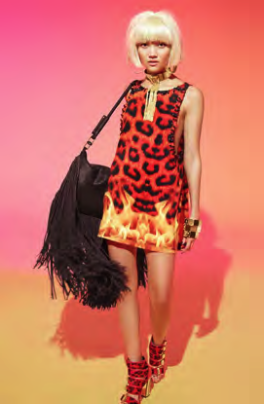
Katie Eary with two of her River Island creations.
Notes:
Graduate’s collection
goes on sale at
DMU fashion graduate Katie Eary has work in HK, Japan, Levi’s now got her own lable.
continued her success story after launching
a collection with the high-street

Slide 16
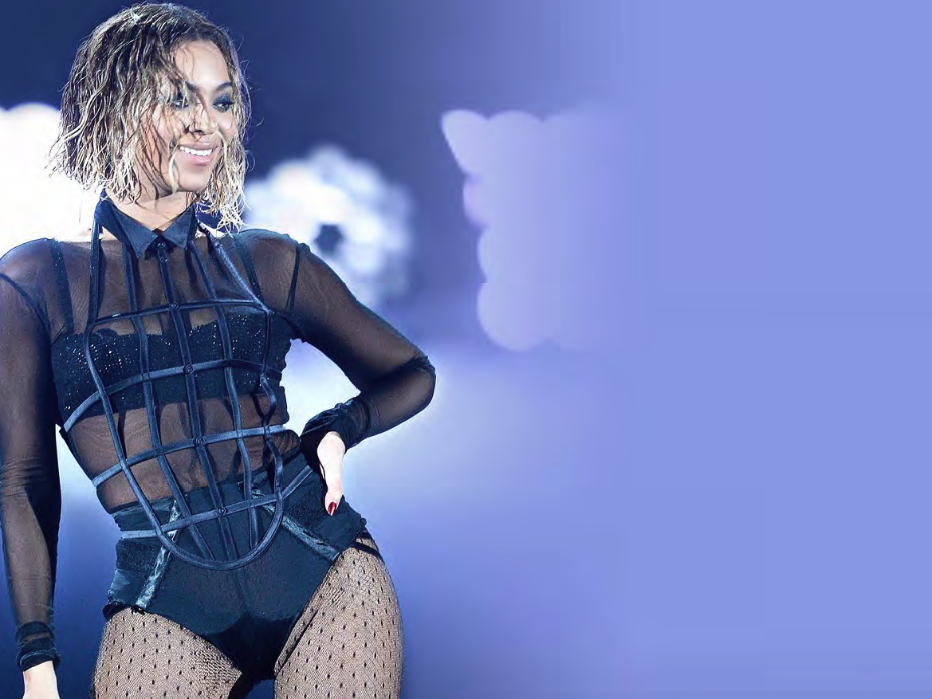
Beyoncé wears DMU graduate’s design to the Grammys.
Nichole de Carle graduated 2005 in contour fashions.

Slide 17
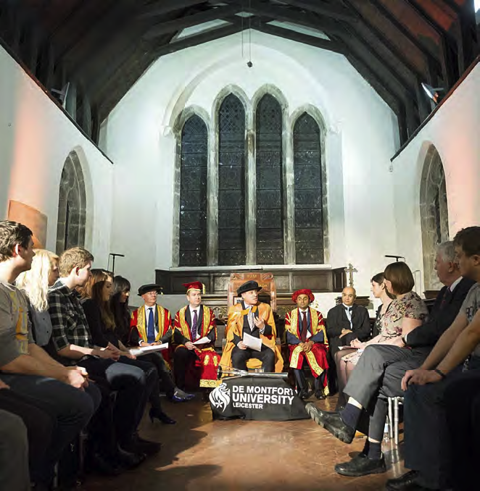
Mr Speaker chairs
DMU student debate
Notes:
The assembly was asked to
discuss the proposition “This House
believes that there is no point voting
in the 2015 General Election.”
After opening speeches, Mr
Speaker called upon members of
the assembly to weigh in to the
argument, deftly allowing rebuttals
and interventions while calling for
“Order” when the debate became
too heated.
The final vote was 63 to 26
against the motion – proving that
young people at DMU do care
about democracy.

Slide 18
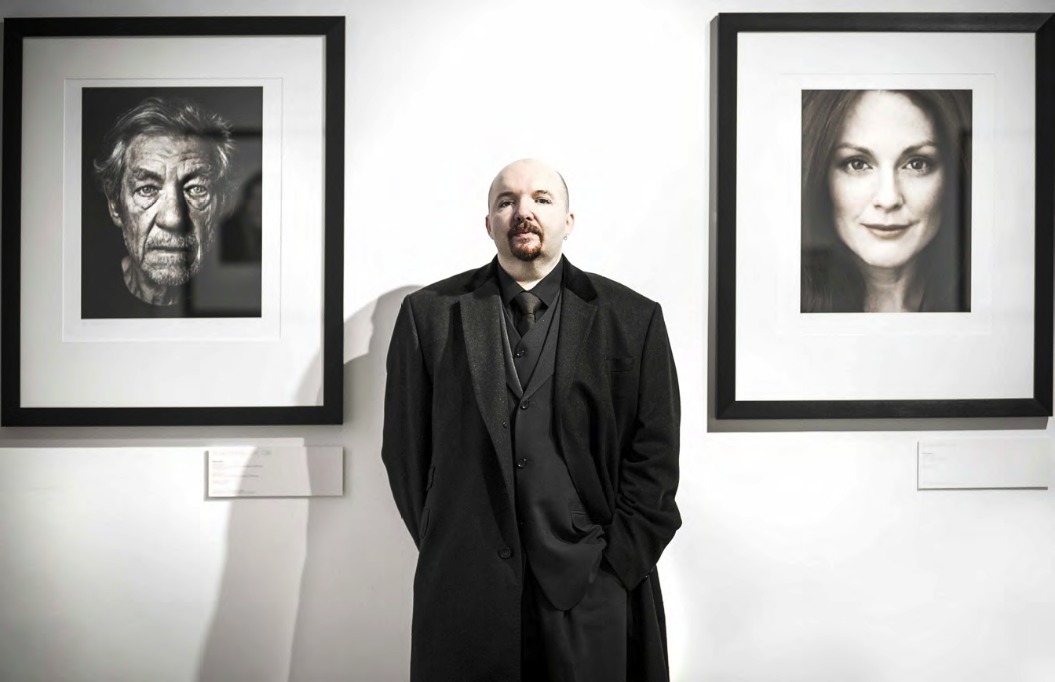
Stunning photographs
of famous actors taken
by DMU graduate
Andy Gotts have been
on show at a Bafta
exhibition.
Andy Gotts at exhibition in Somerset House.
Graduated MA in Photography 2007
Notes:
Photography courses are part of a wide range of creative art and design courses at DMU, which was named one of the top 10 universities for creativity in the Which University? guide for the second year running.

Slide 19


University!
Comedy festival celebrates
21st birthday
Notes:
Geoff Rowe, director of DLCF, began planning the first festival as a DMU student in 1993. Today it is the longest-running dedicated comedy
festival in Europe with more than 600 events over two weeks.
Geoff said: “It all began at DMU so it’s great that the university has
continued to support the festival and me as a graduate for all these years.
“The university is well-known for being a creative institution and I’m proud that it continues to be a sponsor of the event.” Students studying the Arts and Festivals Management degree at DMU were involved in this year’s
festival, running and promoting more than 40 acts in three venues
– The Criterion, The Exchange Bar and Duffy’s Bar.

Slide 20
Programme and Courses :
Art, Design and Humanities
Humanities
Arts and Festivals Management
Creative Writing
Cultural Events Management
Dance
Drama Studies
English (Literature)
English Language Teaching
Film Studies
Global Media
History
International Journalism
Media and Communication
Performing Arts
Public Relations
Management , Law and Humanities of Sport
Sports History and Culture
Art & Design
Animation design
Architecture
Contour Fashion
Design Crafts
Design Innovation
Design Management and Entrepreneurship
Fashion and Bodywear
Fashion Buying
Fashion Design
Fashion Fabrics and Accessories
Fashion Management
Fine Art
Footwear Design
Furniture Design
Game Art Design
Graphic Design and Illustration
Interior Design
Multimedia Design
Photography and Video
Photographic History
Product Design
Sport, Media and Culture
Textile Design
Visual Journalism

Slide 21
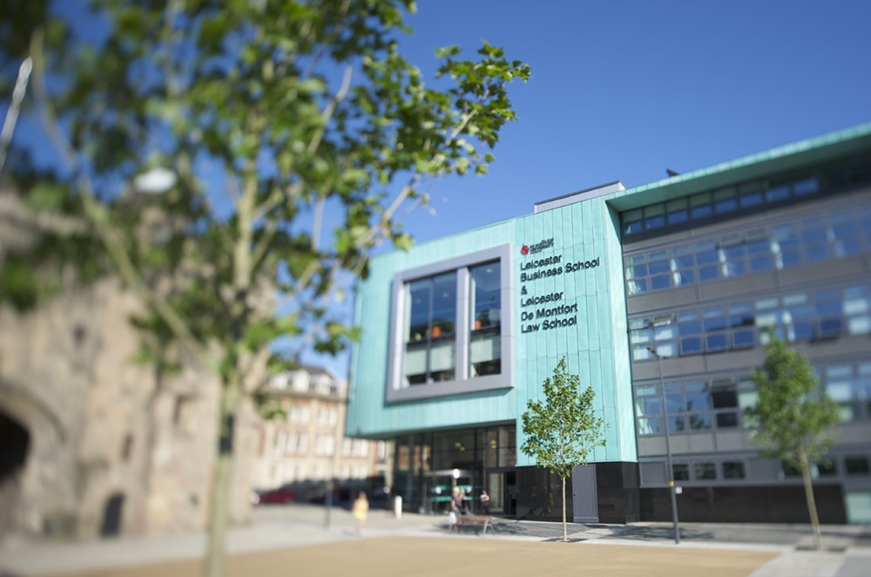
Leicester Business School
One of the largest Business Schools in UK
5000 Undergraduate, postgraduate and professional students, 200 academic staff
60+ nationalities
Six Departments: Accounting & Finance, HRM, Marketing, Public Policy, Strategy and Management, and Corporate Development.

Slide 22








Professional Accreditation
A member of the Association of Business Schools (ABS)
ACCA Approved Learning Partner, Gold Status
CIM Accredited Study Centre
CIMA Learning Quality Partner
CII Accredited Learning Partner
Accredited by the ICAEW
IDM Key Educational Partner
CIH accredited housing qualifications
CIPD Centre of Excellence, one of only 11 in UK
BASL Education Partner
The Law Society Diversity Access Scheme supporter
CIPD Centre
of Excellence
Solicitors Regulation Authority

Slide 23
Programme and Courses : Business and Law
Accounting
ACCA/CIMA
Advertising and Marketing
Banking and Finance
Business
Economics
Finance and Investment
Human Resource Management
International Business
International Relations
Law
Management
Marketing
MBA
Politics and Government
Project Management
Public Administration
Retail Management
Risk Management

Slide 24

Faculty of Technology
Computing Science
Electronic Engineering
Energy and Sustainable Development
Engineering
Global Media
Informatics
International Journalism
Mechanical and Manufacture
Mechantronics
Media Production/Communication
Micro-Electronics
Music technology
Software Engineering

Slide 25
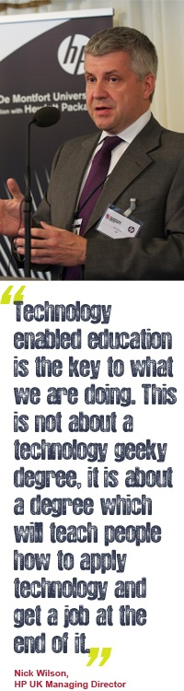
Partnership with HP
Access to Hewlett Packard Academy and Education Innovation Centre (EIC)
New joint programme of BSc Business Informatics (HP)
Expert mentoring and industrial professionals advice
Placement opportunities

Slide 26
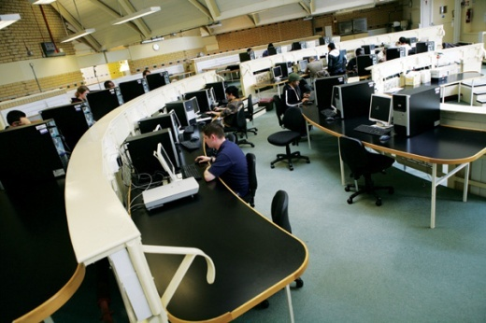



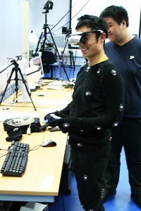
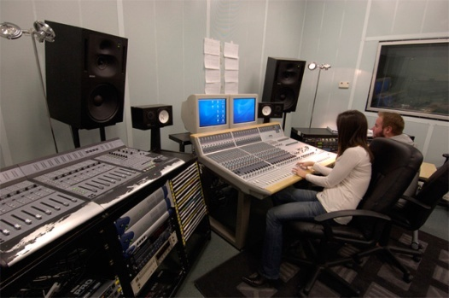
Facilities (Technology Faculty)
Computer Science Labs
Video Editing, DVD Production and High performance applications
Audio, Music and Multimedia applications
Apple Mac Computers
Robotics-Advanced Mobile
Robotics & Intelligent Agents Laboratory
Video Production Labs
Creative Technology Studios:
Digital
Film
Games Development

Slide 27
Programme and Courses : Technology
Animation Design
Audio Recording Technology
Artificial Intelligence with Robotics
Business Information Systems
Communication Technology
Computer Games Programming
Computer Sciences
Cyber Security
Energy Sustainability and Management
Engineering
Forensic Computing
Game Art Design
Graphic Design
Multimedia Computing
Mechanical Engineering
Mechantronics
Music Technology
Radio Production and Technology
Software Engineering

Slide 28
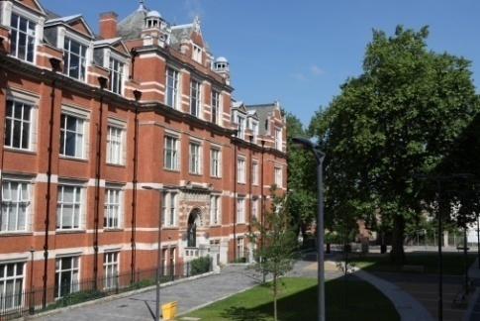
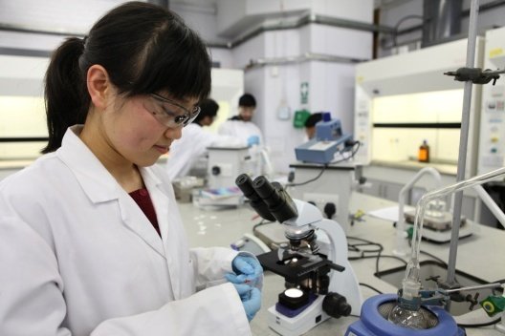

Health and Life Sciences
One of the oldest institutions in the UK responsible for the education and training of pharmacists
Internationally recognised research in the area of science and social sciences
Courses in nursing and midwifery - commended by the Nursing and Midwifery Council (NMC)
Strong links with the National Health Service (NHS) –accredited by professional bodies

Slide 29
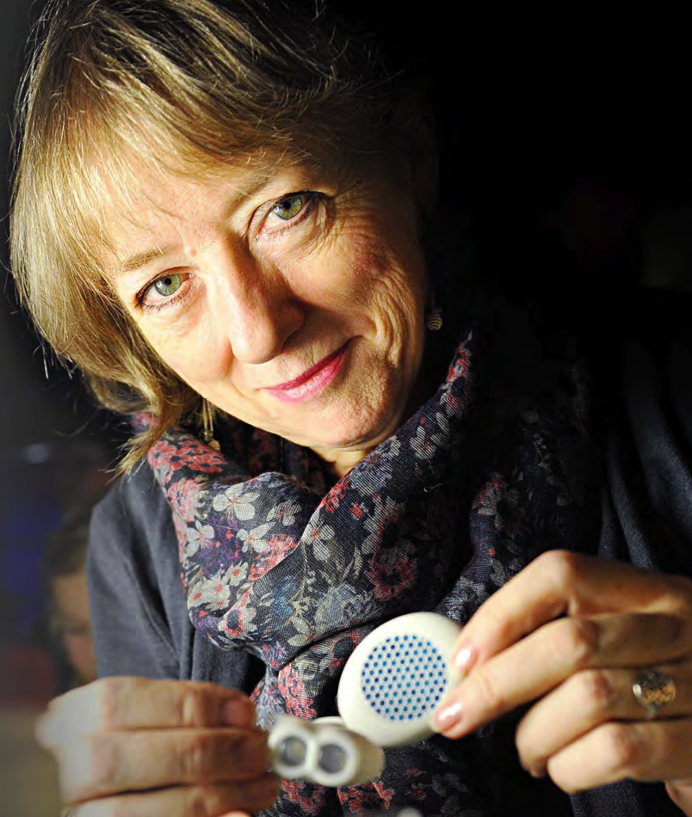
Diabetes costs the NHS £1m per hour.
Prof Joan Taylor has created an artificial pancreas and won a top award this year.
Notes:
he artificial pancreas
has the potential to
revolutionise the lives of
people with diabetes.
Unlike Type 1 diabetes, an autoimmune
disease, Type 2 is largely
driven by lifestyle and linked to
obesity. It is thought there are
almost a million people who have
this condition but do not realise it.
The financial burden on the
NHS for treating the illness is
already £1 million an hour − or
almost £9 billion a year. But that
figure does not take into account
the millions of working days lost.
The artificial pancreas maintains
healthy blood sugar levels round
the clock, minimising the risk of
hypoglycaemia.
It is not powered by batteries
or electronics and has no moving
parts, so the risk of rejection is
very low.
Professor Taylor said: “This
device is cheap and simple to use.
“I believe it should be globally
available, not just here but in some
of the poorest countries.
“After 20 years of research
we are hopeful we have found a
solution which has the potential to
bring an end to the misery of daily
injections for diabetics across the
world within the next 10 years.”

Slide 30
Health and Life Sciences - Courses
Applied Criminology
Biomedical Science
Criminology
Audiology
Education Studies with Languages
Forensic Science
Health and Community Development Studies Health Psychology
Health Studies
Human Communication
Medical Science
Midwifery
Nursing
Pharmacy
Pharmaceutical Biotechnology
Pharmaceutical Sciences
Pharmaceutical Quality by Design
Psychology
Psychological Well-Being
Social Work
Sociology
Youth and Community Development

Slide 31















Careers and Employment
Careers and Employment

Slide 32
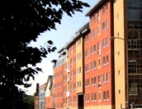
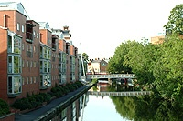
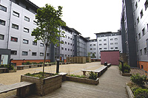
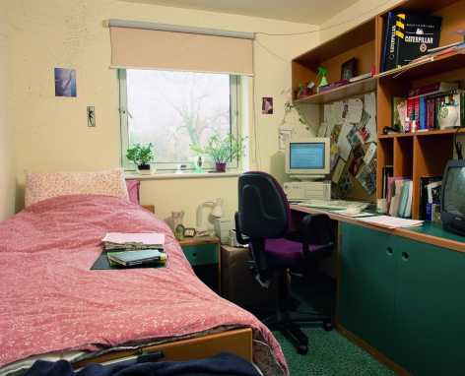
Accommodation
Many halls of residence surround the campus
En-suite or shared bathrooms
Internet access
Private accommodation also available close to campus

Slide 33

English Language Support
10 weeks of English
IELTS 5.0 - 6.0 or IELTS 5.5 - 6.5
5 weeks of English
IELTS 5.5 - 6.0 or IELTS 6.0 - 6.5
** joint/integrated offers available

Slide 34
Tuition Fees for Overseas students
Course | September 2014/January 2015
Foundation (1 year) | £11,250
Pre-masters (1 year) | £10,800
Undergraduate | £11,250 £11,750 - lab based
Postgraduate | £11,700 £12,200 - lab based
MBA | £12,500 / £13,500
PhD | £11,700 (£12,200 lab based)
Distance learning PhD | £5,500

Slide 35
Scholarships
Faculty Masters scholarships
Country specific scholarships
DMU Square Mile International Scholarship
International Alumni Scholarships

Slide 36
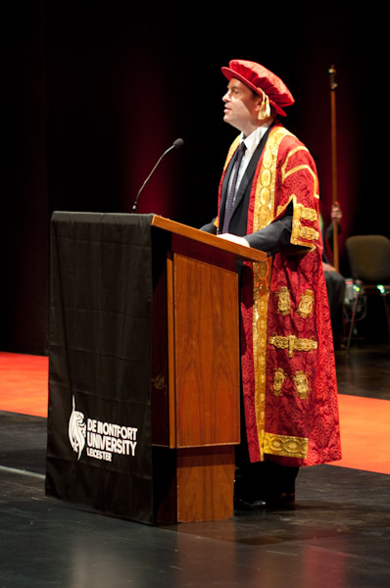
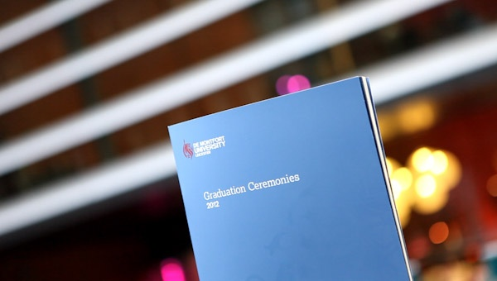
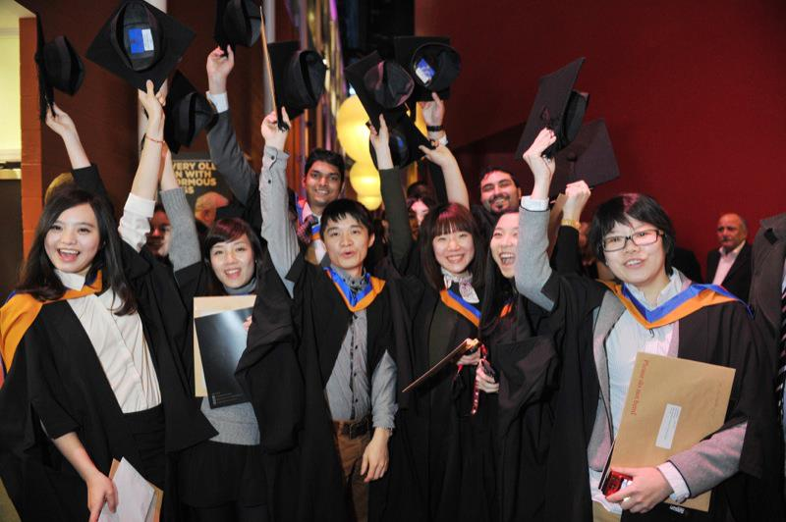
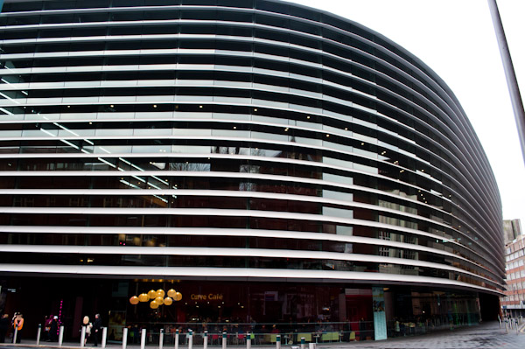
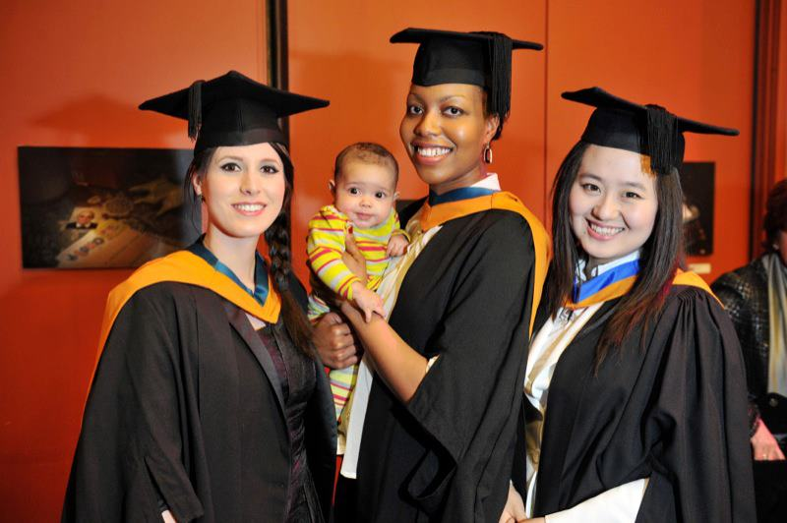
Graduation Ceremony

Slide 37



Social Media Links
DMU
www.twitter.com/De Montfort University
youtube/demontfortuniversity

